Slide 1
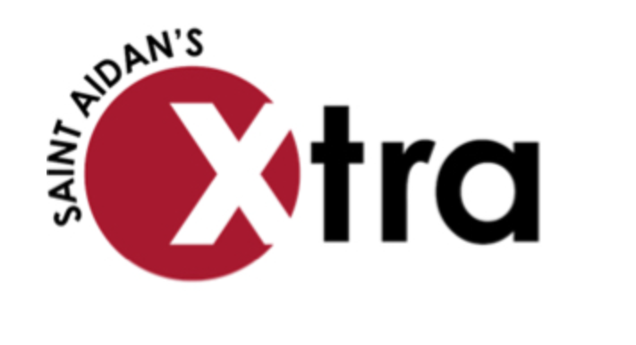

SAINT AIDAN’S CLUBS AND SOCIETIES
As part of our commitment to the holistic growth and development of students, we are delighted to announce our brand new Extra-Curricular programme known as Saint Aidan’s Xtra.
Learning plus is every day from 3.00pm -4.30pm (4.00pm on a Friday) in the Library. Go for a quiet space to complete and get help with your homework.
Attending an Xtra club will go towards your 10:10 award.
GIVE IT A GO! TRY SOMETHING NEW!
VEX ROBOTICS:
IT1 TUESDAY 3.00PM – 4.15PM Build and programme robots, get the chance to enter competitions.
POTTERY CLUB:
ART SUITE TUESDAY 3.00PM-4.15PM Learn basic hand building techniques in clay.
SIGN LANGUAGE CLUB:
C1 WEDNESDAY 1.20PM – 1.45PM come and learn basic conversation in British Sign Language
NEWS!
You recently completed a questionnaire about what clubs and societies you would like to see at Saint Aidan’s. As a result we have some new and exciting opportunities for you all. Check out the ‘Clubs and Societies’ noticeboard on the main corridor, look at the ‘Clubs and Societies’ page on synergy and keep your eye on your form noticeboard for extra opportunities.
NEW TO XTRA!
IT1 Open access Monday, Tuesday and Wednesday lunchtime. All year groups welcome.
Dance club. Monday lunchtime. All years. Old gym.
T2 Open access for 3D printing, On shape and textiles work. Monday, Tuesday and Wednesday lunchtime.
Miss Wood’s lunch club. Play games and make new friends. Yr 8 Wednesday. Year 9 Thursday.
Baking club Wednesday 3.00pm – 4.30pm. Years 7,8 and 9.
SPORTS CLUBS.
Keep your eyes open for details of seasonal sports clubs, these are always changing.
IN FOCUS. MAD CLUB.
Make A Difference (MAD) club is not just a lunch club, MAD is amazing! We plan great fundraisers and make lots of money for charity. We make sure it's a different charity each time and so far this academic year we've raised over £1200! My favourite events we've run so far are the Christmas Fair and the Macmillan Coffee Morning. At the moment, we're working on an appeal for Shoe Aid - a charity who aims to provide homeless people with shoes.
I like MAD club because I like donating things to charity and making a difference to other people's lives, we work with Miss Barks and Miss Patterson and it's a great place to meet new people. Best of all, your voice will be heard!
Niamh Murphy and Ellen Pye (Y7)
Coming next half term: ARCHERY CLUB. You asked, we delivered!

